Slide 1
Ion implantation

Slide 2
Ion Implantation
Ion implantation is the mainstream doping method in semiconductor industry:
Precise dose control
Easier masking
Large range of doses (from 10¹¹ to 10¹⁶ atcm⁻²⁾
Accurate depth control

Slide 3
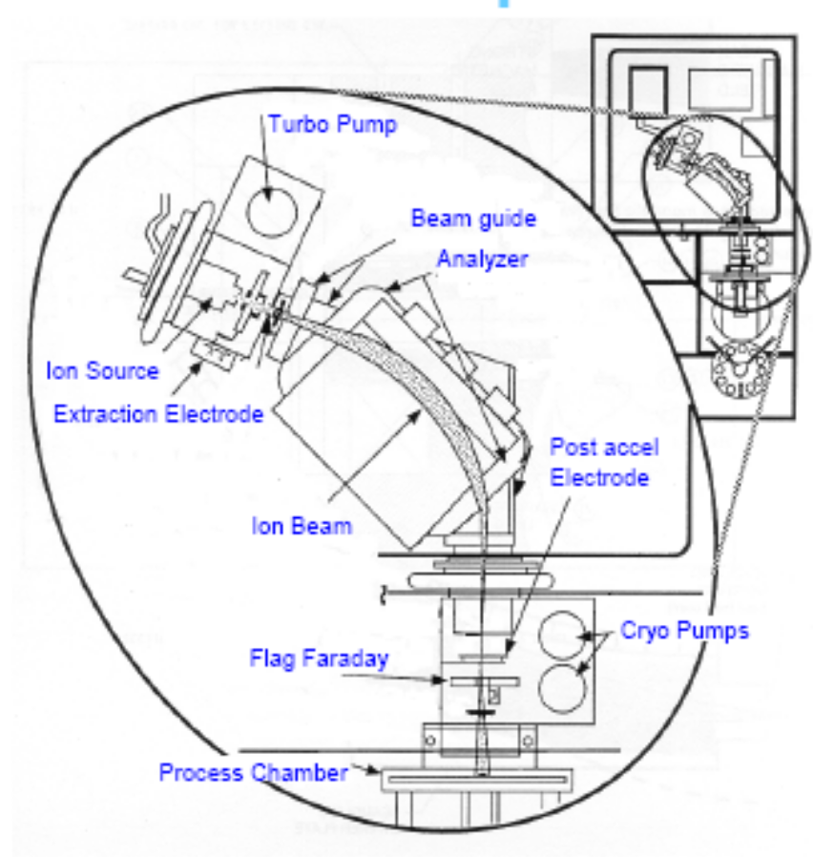
Implanters
Ion Source
Extraction Area
Analyzer
Focusing System
Acceleration Column
Dose computing
Process Chamber
Micron Confidential
2/14/2025
3

Slide 4
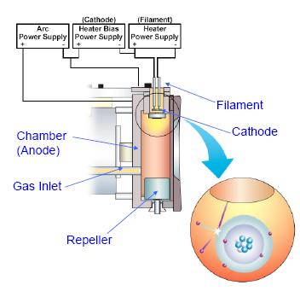
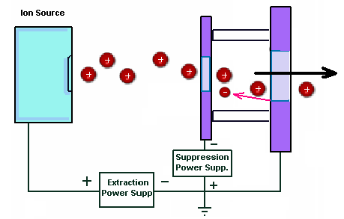
Implanters: ion source and extractor
A vaporized solid sample or gases are used as sources
Gases are ionized by energetic electrons coming from a an arc discharge.
  Filament at large negative potential with respect to an anode plate
  A magnetic field is added so that electrons have helicoidal trajectories, to increase ionization probability
  Exit side is biased to a large negative potential with respect to the filament
  An exit slit “shapes” the ion beam
Notes:
La sorgente ha la funzione di generare un plasma da cui estrarre la specie drogante da impiantare. Tutto cio’ a partire da un fissato gas sorgente:
Trifluoruro di boro (BF3);Fosfina (PH3);Arsina (AsH3).
Il meccanismo di funzionamento e’ il seguente. Il gas viene inettato attraverso una lineadirettamente all’interno della sorgente (fig. 24). Un filamento in tungsteno (20V; 200A)genera termoelettroni che collidono con le molecole del gas producendo la dissociazionenei suoi costituenti atomici piu’ molecole di massa minore, il tutto con differenti gradi di ionizzazione (fig. 25).
Il filamento puo’ essere schermato da un catodo che ha funzione di emettere elettroni secondari sotto il bombardameto da quelli emessi dal filamento (fig. 26). Inoltre le sorgenti possono essere dotate di uno o due filamenti (fig 24). Gli elettroni secondari verranno accelerati verso le pareti della camera da un potenziale positivo, definito Arc voltage (+80V) e respinti da un Repeller in
modo da confinarli in prossimita’ del catodo. Per aumentare la probabilita’ di urto dell’elettrone con una molecola di gas esso viene costretto a percorrere un tragitto a spirale da un campo magnetico (fig. 27 e 28).
Gli ioni generati all’interno dell’Arc Chamber vengono estratti da una differenza di potenziale
applicata tra la camera stessa ed un elettrodo estrattore che e’ posizionato di fronte
ad una fenditura della camera.
Il potenziale applicato e’ generalmente compreso tra 20 ed 80 KV e fornisce una energia allo
ione che spesso e’ quella finale del processo di impiantazione (eventualmente una seconda
accelerazione al fascio viene fornita dalla colonna acceleratrice). Sull’elettrodo e’ applicata una
Front Slit che ha la funzione di focalizzare il fascio ed immediatamente prima di essa e’
presente un secondo elettrodo detto soppressore. La sua funzione e’ quella di impedire agli
elettroni che si generano a causa degli urti degli ioni sulla front slit di poter tornare indietro
verso la sorgente e generare raggi X. A tal fine il soppressore opera generando un potenziale
piu’ negativo (-2 KV) rispetto all’elettrodo estrattore (fig. 29). Gli elettrodi estrattore e
soppressore sono meccanicamente vincolati e possono variare la posizione in relazione alla
sorgente lungo i tre assi (manipolatore). Cio’ permette di focalizzare il fascio ionico un una
successiva fenditura (Defining aperture) collocata prima dell’analizzatore di massa (fig. 30).

Slide 5
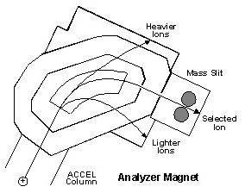
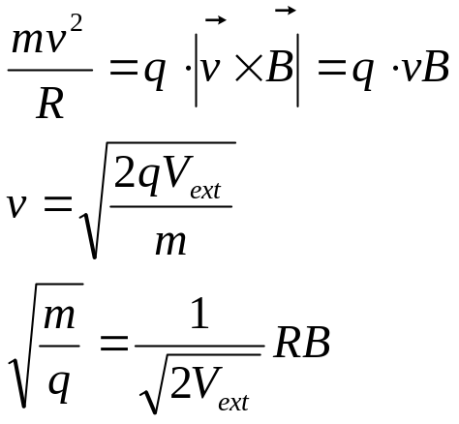
Implanters: analyzer
Correct ions extracted from the source chamber are now selected:
In the analyzer chamber, a magnetic filed B is kept perpendicular to the beam
  Then:
Different ion mass( to charge ratios ) can be selected by tuning B

Slide 6
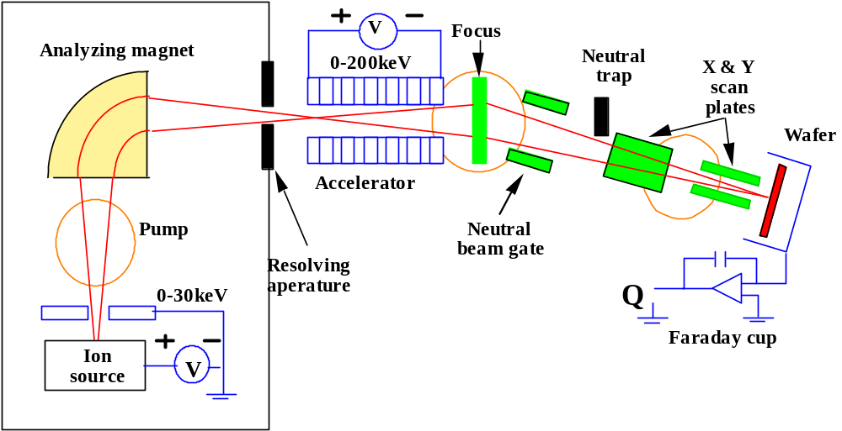
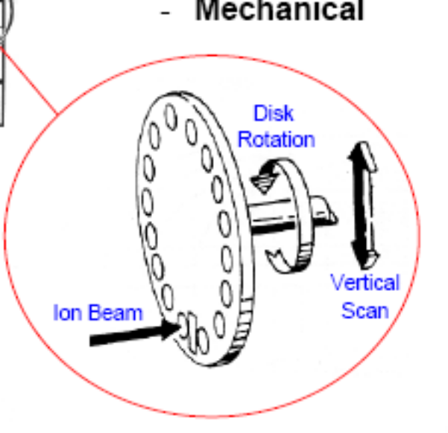
Implanters: acceleration, dosimetry and process chamber
Selected ions are accelerated (if needed) by a linear accelerator
An electrostatic deviation filters the beam form neutrals ( usually ions that absorbed a thermal electron)
The beam can be rastered on the wafer by electrostatic deflection plates, or the wafer itself is moved mechanically (see picture).
The wafer is placed in a “Faraday cup” → all the charge is collected and a current is measured.

Slide 7
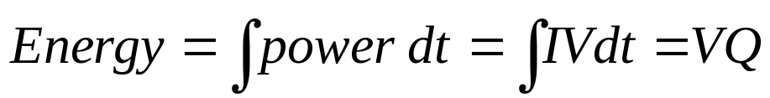
Ion beam heating
Ion implantation raises temperature in Si (and in masking material)
For a dose of 5E15, at 60 KeV, 20kJ can be deposited on a 200mm wafer.

Slide 8
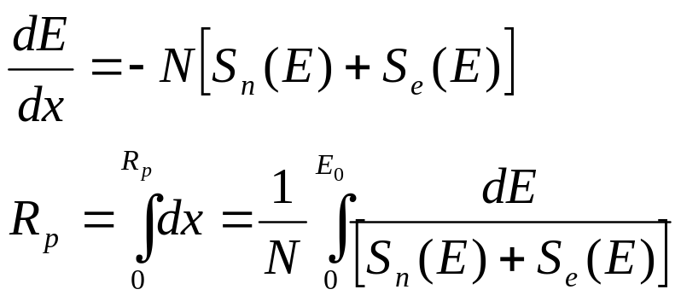
Stopping mechanisms
The ion trajectory in silicon is deterministically known:
  The ion scatters from target atoms ( two body collision)
  It’s dragged by electrons
Target atom density
Electronic stopping power
Nuclear stopping power

Slide 9
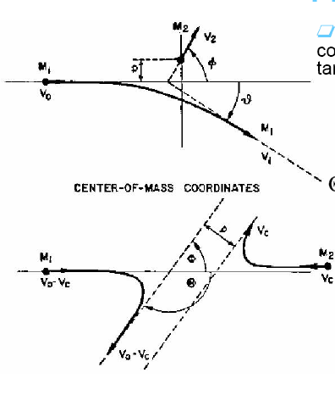
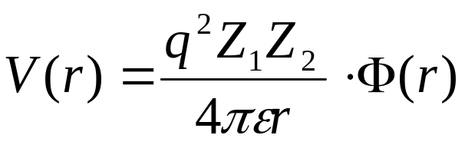
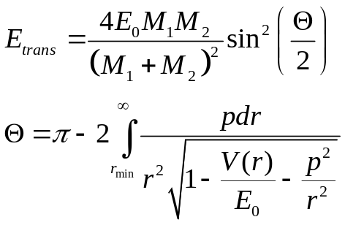
Nuclear stopping
Can be modelled as a Coulomb scattering, with a potential modified to account for electrons shielding:
Electron shielding correction factor
S_{n}(E) is small at high energies
Dominates at the end of range ( where most of the damage is produced)

Slide 10
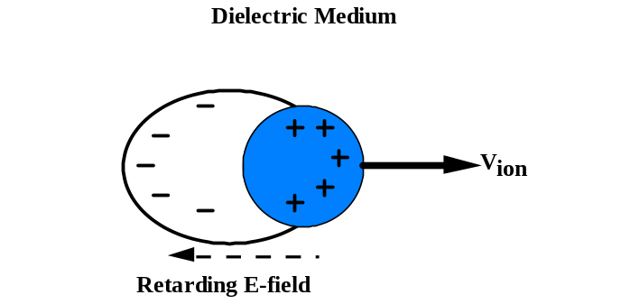
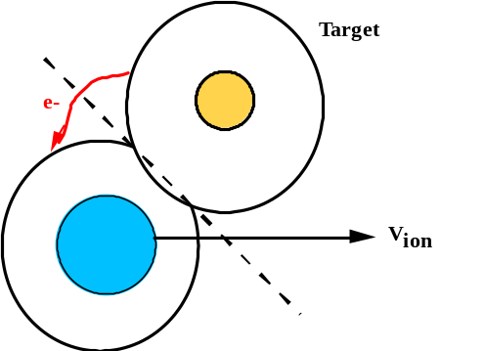
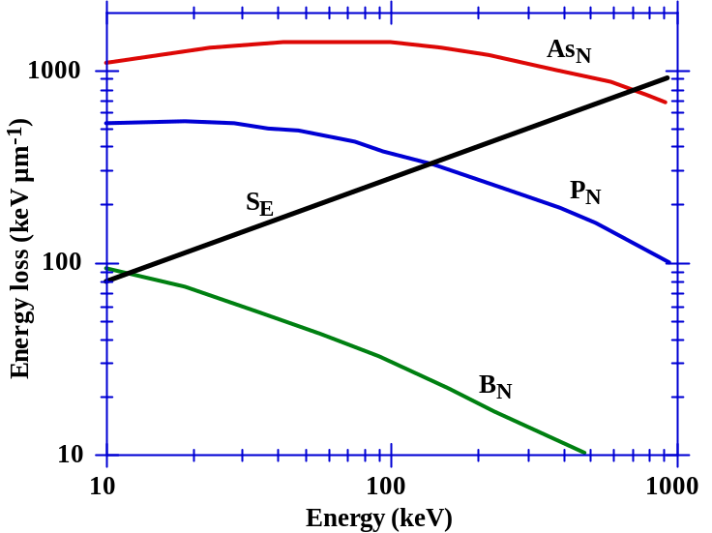
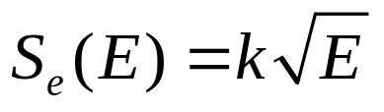
Non local and local electron stopping
Non local electronic stopping:
  A stationary charged ion creates a polarization field in the semiconductor
  The polarization field “lags” behind a moving ion → an drag force is produced.
  Similar to motion in a viscous medium
Local electronic stopping:
  Momentum exchange with orbital electrons
Both depend on ion velocity, thus we can write
Notes:
Sottolineare che il numero e il tipo di interazioni dipendono fortemente dal tipo di impianto (es. angolato o no), dal tipo di ione, dal numero di eventi di channeling che si producono.
Solo simulazioni Montecarlo forniscono una previsione accurata dei profili dopo impianto.

Slide 11
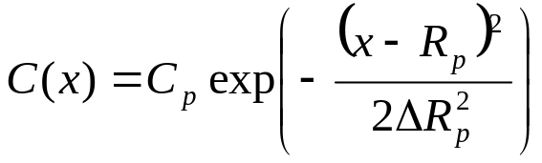
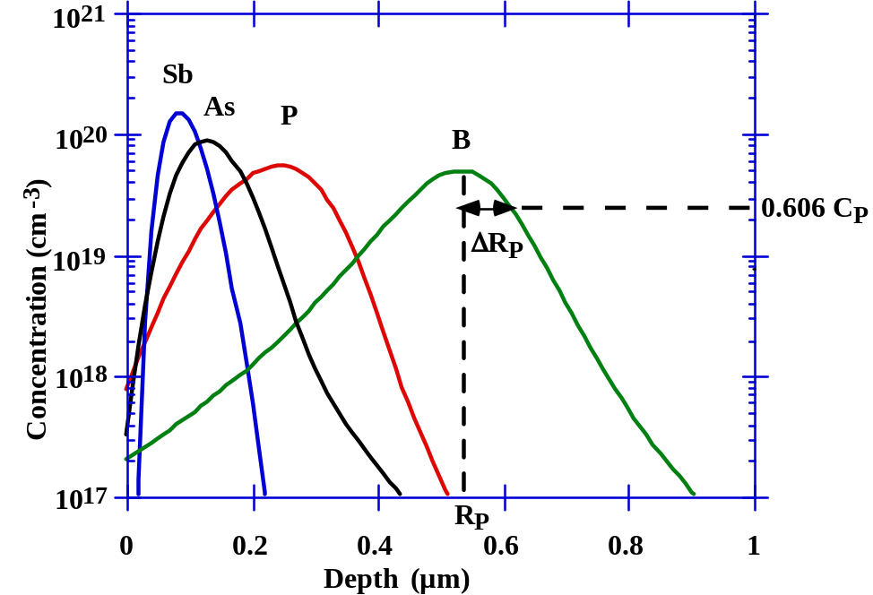
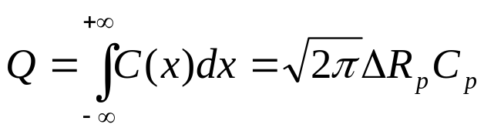
Gaussian approximation: projected range and straggle
The ion implantation is a random process ! (since every ion follows a random path in the crystal)
To first order, ions distribution around projected range can be approximated to a Gaussian.
where:
C_{p} is the concentration at R_{p}
R_{p} is the projected range
ΔR_{p} is the straggle ( or standard deviation)
The total dose Q is given by

Slide 12
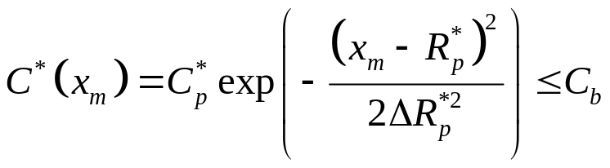
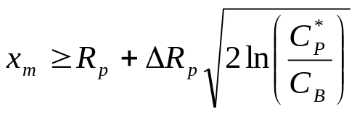
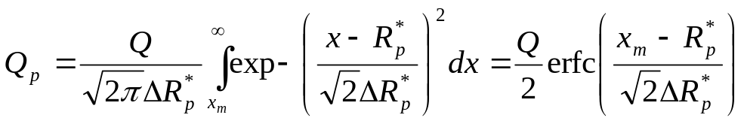
Stopping power and masking
Ions must be generally implanted only in some zones of the wafers, the other zones are masked by a masking material (e.g. SiO₂, photo-resist, transistor gates)
Efficient masking condition:
C*_{p}
x_{m}
C_{B}
C_{p}
Dose penetrating the mask:

Slide 13
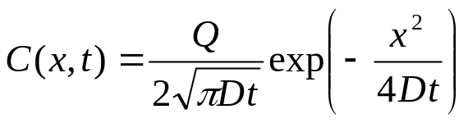

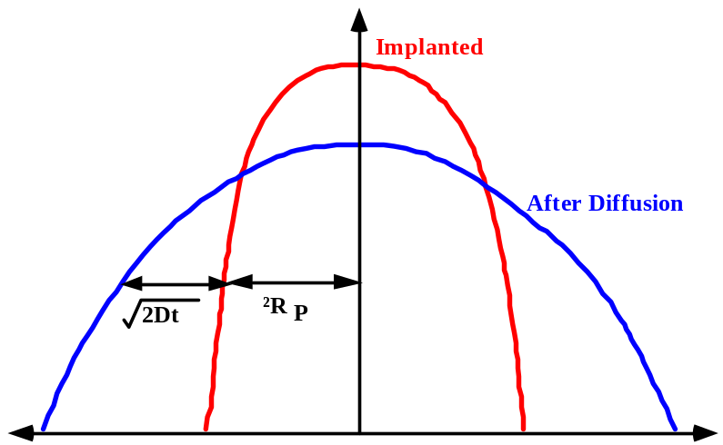
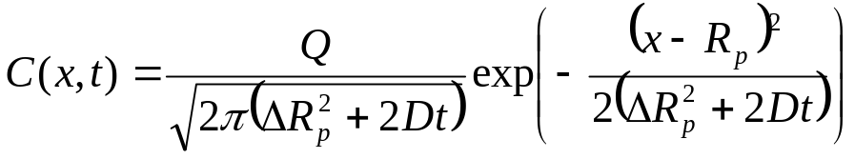
Diffusion of gaussian profiles
Remember that a diffusion of a delta function of dopant is:
We can thus consider our gaussian implanted distribution as a diffusion of a delta function with
The effect of an annealing on our implanted distribution will be:

Slide 14
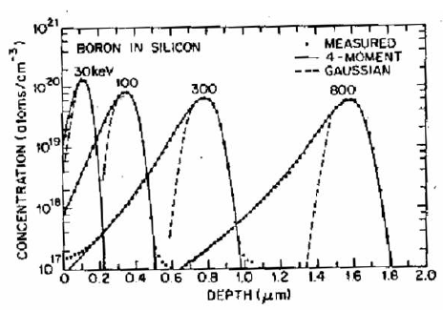
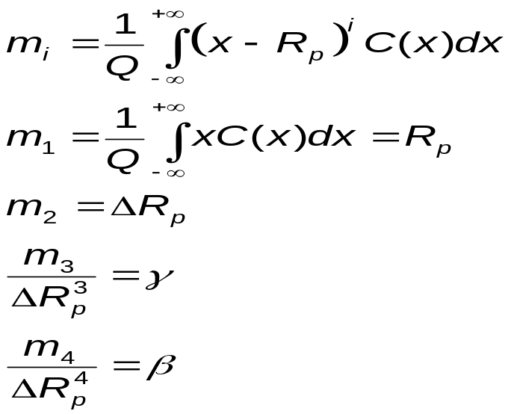
Higher level moments
Actual concentrations can be approximated to a Gaussian only nearby the peak region
An arbitrary function can be described by “moments”:
Skewness ( 0 for a Gaussian)
Kurtosis (3 for a Gaussian)
Higher order moments can be used to generate more accurate distribution (es. Pearson’s equation)
Notes:
Spiegare cosa sono skewness e kurtosis
Sottolineare la forma della distribuzione del B: ioni leggeri “rimbalzano” all’indietro piu’ facilmente

Slide 15
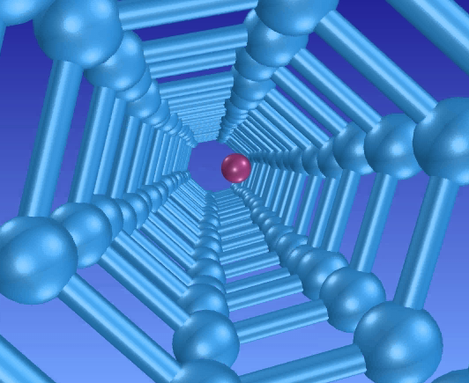
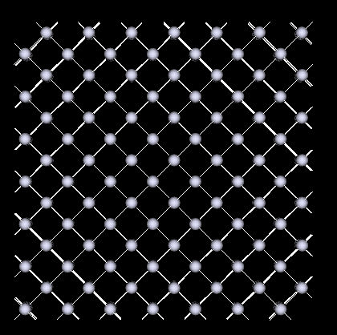
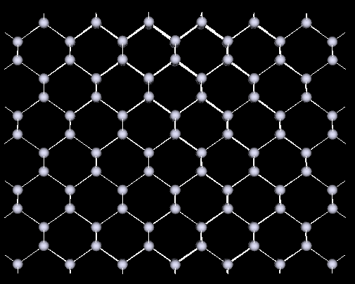
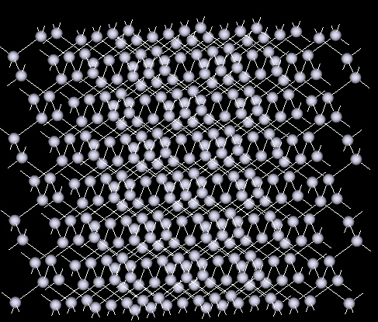
Channeling
If ion velocity is along a symmetry direction in the crystal, the ion can “channel” in the lattice → huge effect on doping profile.
To avoid channelling:
Implant in amorphous silicon
Use an amorphous screen oxide
Sample tilt
100 plane
110 plane
Arbitrary tilt

Slide 16
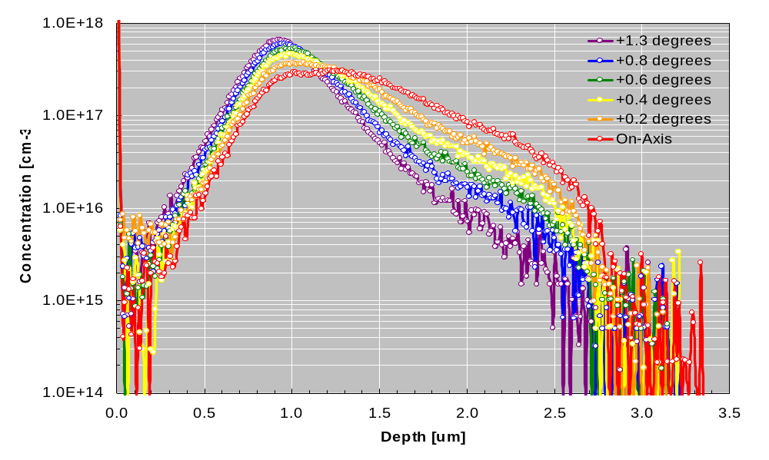

Slide 17
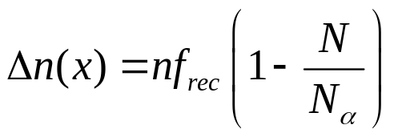
Damage
Displacement energy in Si ≈15 eV
  Is the energy needed to displace a Si atom from its lattice site and create an interstitial and a vacancy [ Frenkel pair]
  Typical implanted ions can easily displace silicon atoms → damage is produced in the silicon crystal during implantation.
For every ion:
A number n of Si atoms are knocked off their lattice site
Some of the defects recombine while the ion stops
Every new ion creates an additional damage that can be written as:
Pre-existing damage (from previous cascades)
Recombination within a cascade
Amorphizing damage

Slide 18
Annealing and damage evolution
A simple but powerful model:
  At relatively low temperature (400 °C) most of the interstitials and vacancies (Frenkel pairs) recombine (they can of course recombine independently at surface).
  Only the interstitial left when the doping atoms have occupied their final lattice sites are left → +1 MODEL
  No experimental proof, but gives a good estimate of excess interstitials
What happens to the excess +1 interstitials?

Slide 19
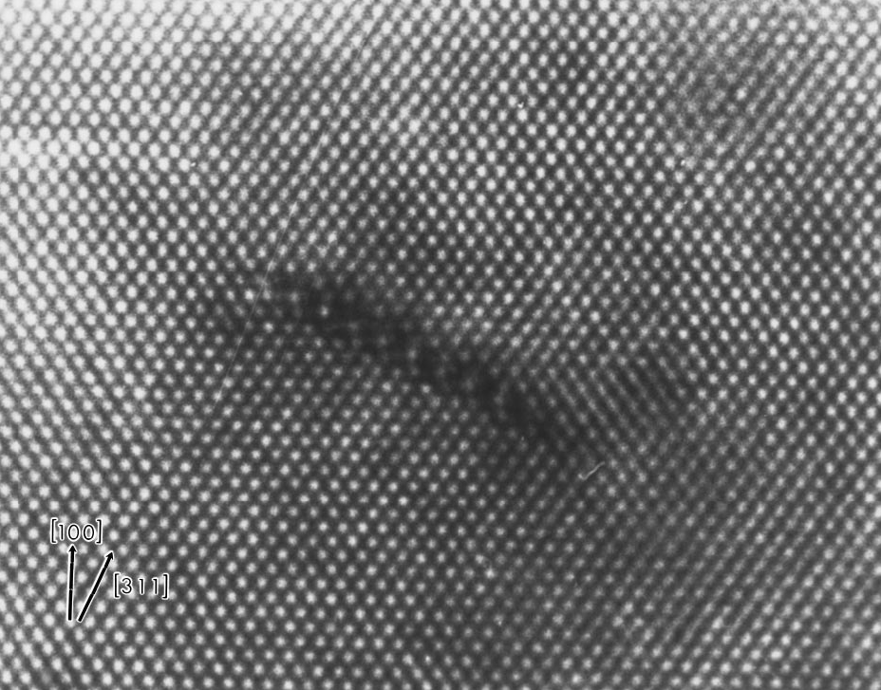
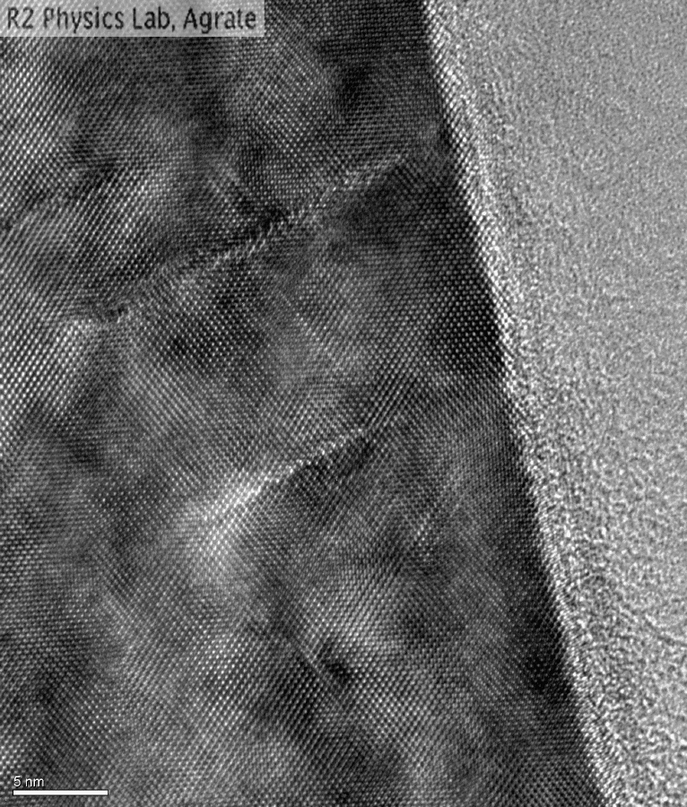
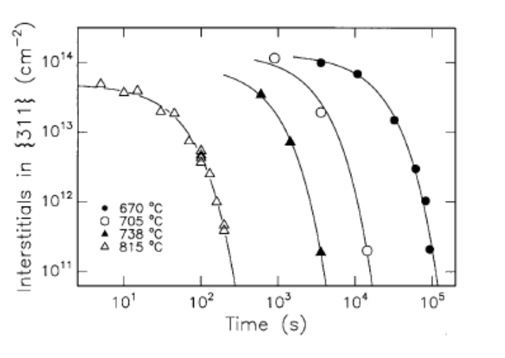
Annealing and damage evolution
Upon further annealing excess interstitials tend to agglomerate in small rod-shaped clusters on {311} planes, extending in <110> directions
Depending on the amount of damage (and distance from the surface…) they can:
Disappear by “evaporation” of interstitials from the ends (and recombination at surface)
Turn into dislocation loops (see next slide)
  Loops can agglomerate to form huge dislocation
  They can be dissolved at very high T (>1100 °)

Slide 20
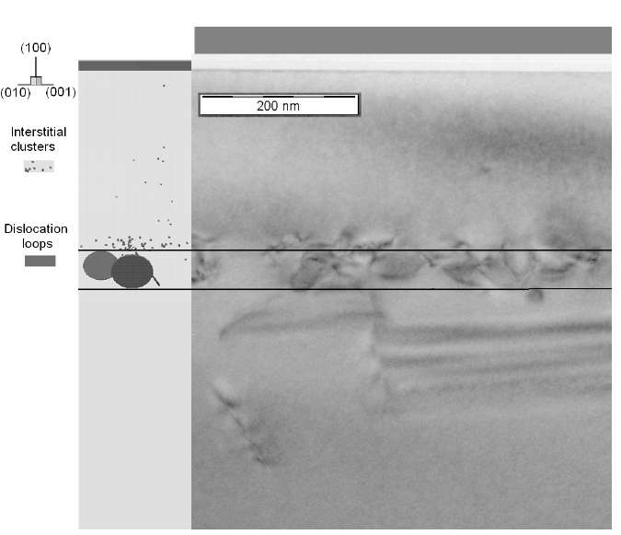
Annealing and damage evolution
Example:
80 Kev 1E15 B implant
30 min 900 °C annealing
Dislocation loops are easily detectable at the projected range (were also predicted by simulation [left])

Slide 21
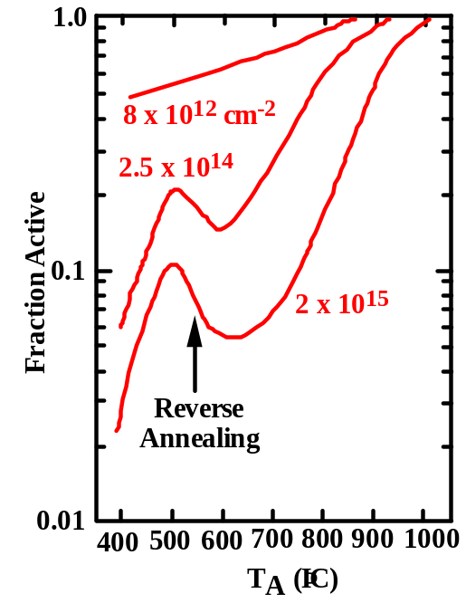
Activation
To be active dopants must be in substitutional position:
  Post implantation anneal has also the function to activate dopants
  For low doses or for amorphizing implants good activation is obtained at relatively low T (600 °C)
  Things are not so easy for high-damage implants (e.g. E15 at/cm⁻² B):
    Excess interstitials compete with B for substitutional sites
    I/B inactive complexes

Slide 22
Annealing vs diffusion
Annealing after implantation is mandatory :
  To dissolve defects
  To re-grow crystalline silicon if necessary
  To activate dopants
BUT
At high temperatures diffusion also occurs:
  diffusion can be particularly enhanced by implantation-induced defects → TED

Slide 23
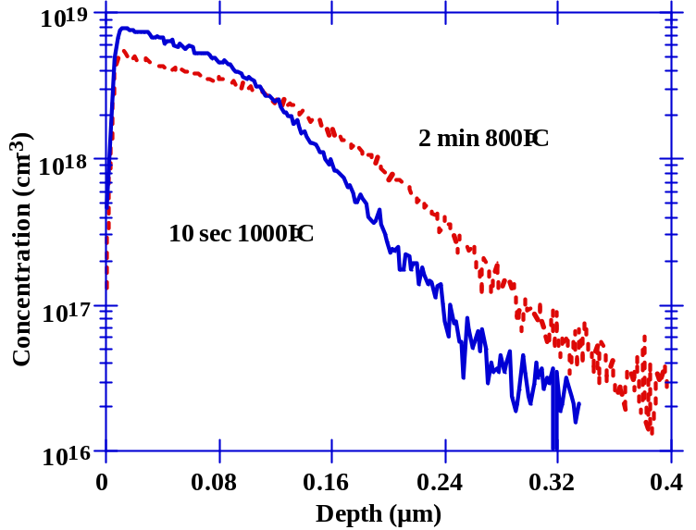
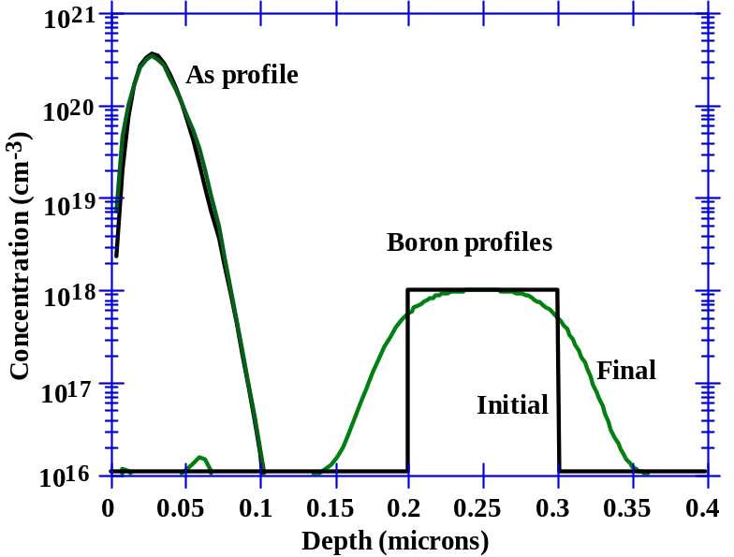
Transient Enhanced Diffusion
• TED is the result of interstitial damage from
the implant enhancing the dopant diffusion
for a brief transient period.
• It is the dominant effect today that determines
junction depths in shallow profiles.
• It is anomalous diffusion, because profiles can
diffuse more at low temperatures than at high
temperatures for the same Dt.
• The basic model for TED assumes that all the
implant damage recombines rapidly, leaving
only 1 interstitial generated per dopant atom
when the dopant atom occupies a
substitutional site (the +1 model).
After 900˚C, 1 sec anneal, the amorphous As
surface profile recrystalizes by SPE without
much TED.
• The buried boron layer is drastically affected
by the +1 interstitials in the As tail region.

Slide 24
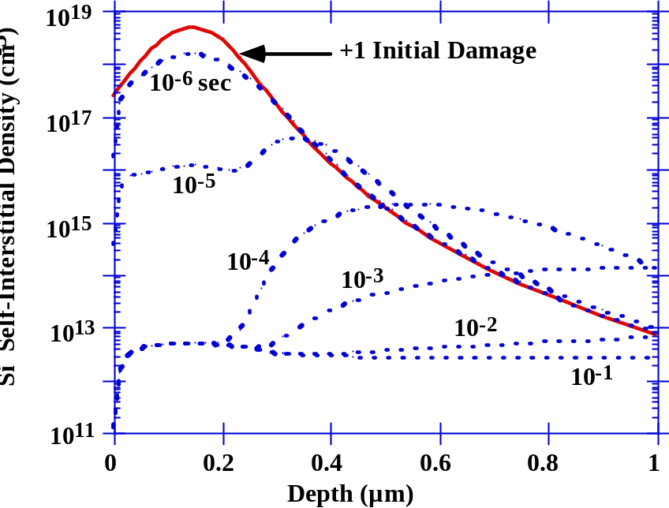
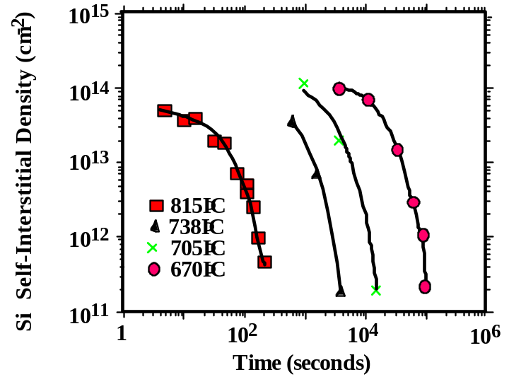
TED:atomic-level mechanisms
{311} clusters form rapidly and then are stable for extended periods (sec - min), driving TED by emitting I while they shrink.
By 0.1 sec (750˚C), the {311} defects have formed and C_{I} is down to ≈ 10¹³ cm-3
But C_{I}*≈ 10^8 cm-3 at 750˚C, so the enhancement is > 10⁵!
On a much larger time scale, the {311} clusters decay.
TED lasts hours at very low T, minutes at intermediate T and msec at very high T.

Slide 25
TED: effects on devices
Reverse short channel effect is explained by TED.
  Damaged induced by S&D junctions implants “pushes” channel species (B) towards the surface
  Threshold voltage is thus increased
  The effect is more pronounced for short channel devices

Slide 26
SPE
If the Si crystal has been amorphized during implantation:
  Crystalline structure can be reconstructed by Solid Phase Epitaxy
  Silicon re-grows in crystalline phase using the undamaged substrate as a “seed”:
      SPE is a quick process (50 nm/min @ 600°C in <100> orientation)
      Activation energy for re-growth rate = 2.3 eV (Si-Si bond braking/formation)
      Its quicker if substrate is doped → easy annealing of defects and activation of dopants
      Growth fronts can be two → from the top surface and from the bottom → clam-shell defects.

Slide 27
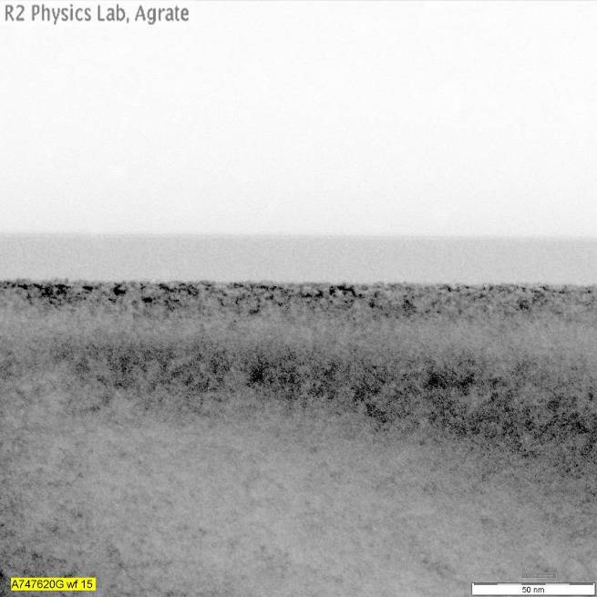
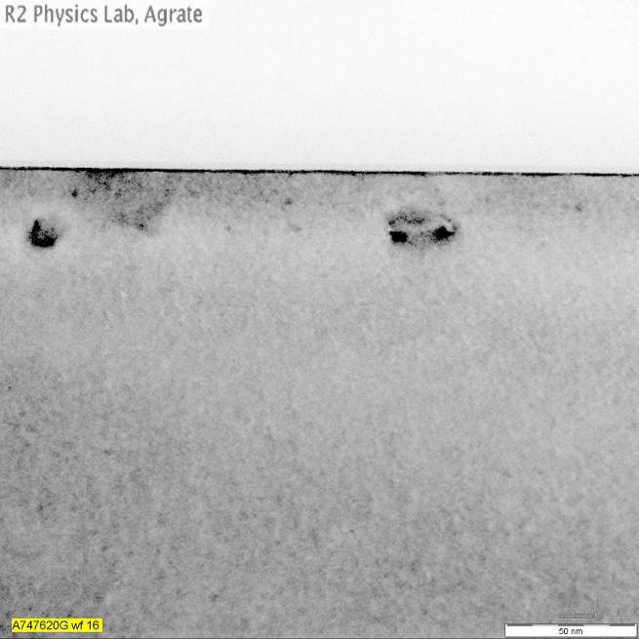
Amorphization: some TEM pictures
After implant
After annealing: end of range defects are visible

Slide 28
Key ideas
Ion implantation is the mainstream doping method in IC industry nowadays:
  Wide range of doses and energy (i.e. depth)
  Precise dose control
  Easier masking
Implanted profiles can be thought as gaussian (with some corrections)
Si crystalline structure is important (channelling)
Crystalline damage is produced for every ion implantation ( Si displacement energy is much lower than any implant energy)
Damage can be recovered by annealing but can also generate extended defects
Damage (interstitials) plays a key role in implanted species diffusion (TED)

Slide 29
Main doping challenges
Ultra-shallow junctions formation
3D doping

Slide 30
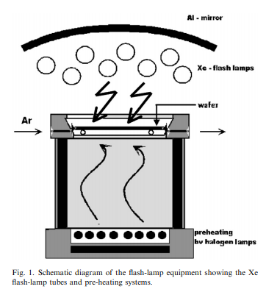
Ultra shallow junctions → high T annealing
TED effect is dominant at relatively low T → apply high temperature anneal processes for a very short time
RTP: second time range
Flash anneal [Xe flash lamps heat the wafer after a pre heating has been performed by halogen lamps]: millisecond time range
Laser anneal [a laser beam scans the wafer at about 300mm/s speed]: mircoseconds time range
Note: laser melting and liquid phase epitaxial regrowth have been successfully used in point defect engineering. Tailoring the pre-amorphization implant depth to match the melt depth of the laser anneal can lead to a virtuous interaction between laser-created vacancies and end of range interstitials, suppressing TED effects
Vacuum 81 (2007) 1301–1305

Slide 31
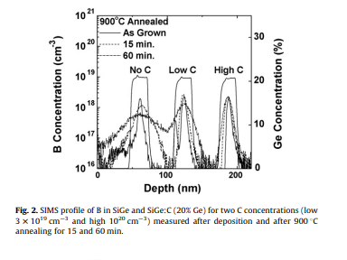
Ultra shallow junctions → defect engineering
Co-implantation
  Impurities that compete with dopants in interacting with point defects are implanted , reducing the super-saturation of point-defects
    C corm C-I clusters in Si and Si-Ge, reducing B diffusivity
    F forms F-V clusters reducing V-assisted diffusivity
Applied Surface Science 254 (2008) 6013–6016

Slide 32
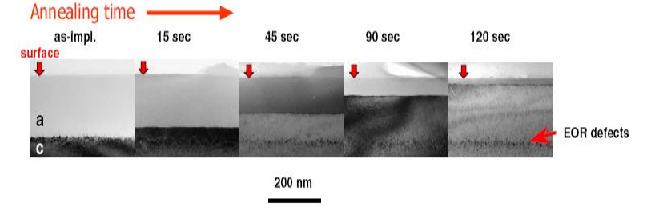
Ultra shallow junctions → defect engineering
Amorphization
  High energy self-implantation (or similar techniques) can be used to form amorphous zones
  Depth is tailored to contain the subsequent implant
  SPE re-crystallizes starting from undamaged wafer
  End of range defects play an important role

Slide 33
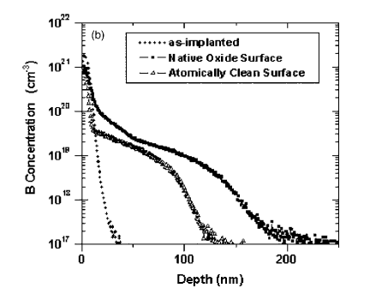
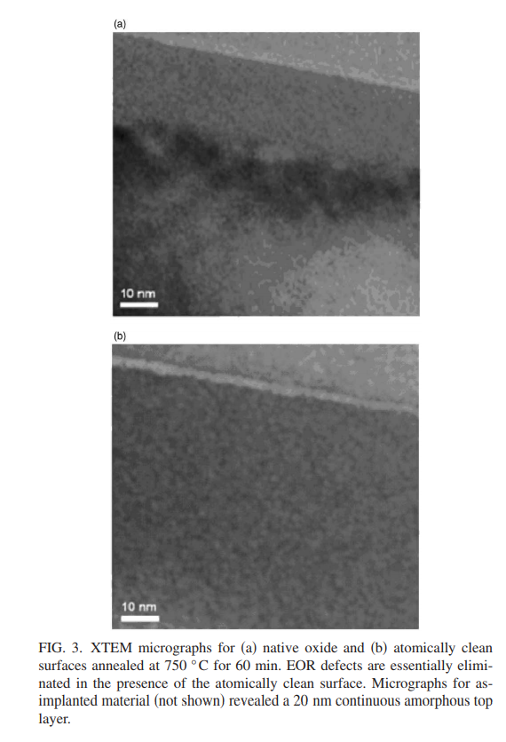
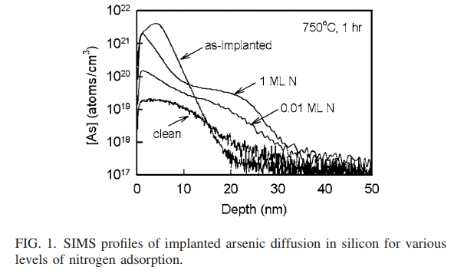
Ultra shallow junctions → defect engineering
Surface treatment
  The wafer surface acts as a sink for interstitials annihilation → wafer surface treatments can significantly modulate dopant-point defects interactions and thus dopant diffusion.
  Having an atomically clean surface, and thus a higher number of dangling bonds, significantly increases the probability of interstitial adsorption.
  Both ultra-low pressure NH3 treatments and high vacuum annealing after native oxide removal have been shown to significantly reduce arsenic and boron diffusion, even in the presence of pre-amorphizing implants.
Appl. Phys. Lett. 91, 102112 2007
Appl. Phys. Lett. 89, 152114 2006

Slide 34


3D Doping
Ion implantation is perfectly suitable for planar devices.
Things start to get tricky when dealing with 3D devices
http://www.maltiel-consulting.com/Unit-cell_wordline-WL-pitch-Hynix%2044-31nm.jpg
https://hothardware.com/news/intel-details-advanced-10nm-node

Slide 35


3D doping → Plasma doping
In a plasma doping system, the wafer is immersed in a plasma of doping ions. A pulsed voltage is applied to the wafer, and ions are accelerated though the sheath region into the wafer at every pulse. The dopant depth is controlled by the applied pulsed voltage.
With such a relatively simple tool, doses several times higher than conventional beam line doping can be obtained, very limited or no charging of the wafer is produced, and the dopant distribution is intrinsically conformal, making this technique a natural approach for 3D structures doping
https://docplayer.net/1016013-A-plasma-doping-process-for-3d-finfet-source-drain-extensions.html
S. Qin, «PLAD (Plasma Doping) on 22nm technology node and beyond- Evolutionary and/or revolutionary,» , 12th International Workshop on junction technology, 2012.

Slide 36

3D doping → Molecular monolayer doping
Self-limiting reactions are used to form a mono-layer of B or P containing molecules, covalently bonded to the silicon surface.
A subsequent rapid thermal annealing process ensures the molecule bond breaking and the dopant diffusion.
The dose of the dopant can be modulated by combining dopant-containing and “blank” precursors during the deposition process.
The dopant diffusion depth can be controlled by modulating the RTA temperature.
nature materials VOL 7 JANUARY 2008

Slide 37
Bibliography for this lesson
J.D. Plummer, “Silicon VLSI technology. Fundamentals, practice and modeling” , Prentice Hall 2000
S.A. Campbell, “The science and engineering of microelectronic fabrication”, Oxford University Press 2001
V. Soncini, “Ion implantation”,ST microelectronics internal course, unpublished
P.A. Stolk et al., “Physical mechanisms of transient enhanced dopant diffusion in ion-implanted silicon”, J. Appl. Phys. 81(9), 1997
M.L. Polignano et al., “The evolution of the ion implantation damage in device processing”, Material Science and Engineering B, in press (available on line)

